Slide 1
An Approach to Recognize Sanskrit Symbol to English using Deep Learning
Submitted by: Pranta Chowdhury
Id: 2104010202176

Slide 2
MOTIVATION
Useful in OCR, language research, and educational tools.
03
Automation aids preservation of ancient manuscripts.
02
Digitizing handwritten Sanskrit texts is difficult.
01

Slide 3
OBJECTIVES
Design
Design and train a Vision Transformer for Sanskrit symbol recognition.
Eye to achieve
Deploy
Deploy model through a web interface using Streamlit.
High Accuracy
Ensure high accuracy
Preservation
Digital preservation of ancient documents.

Slide 4
DATASET DESCRIPTION
01
02
NAME
CLASS
DATASET
Devanagari Character Dataset.
46 classes of handwritten characters.
The heart of the model
03
04
IMAGE
SPLIT
Images resized to 224×224 pixels
80% training,
20% testing

Slide 5
SYSTEM ARCHITECTURE
Input
Preprocessing
ViT Model
Output
Prediction

Slide 6
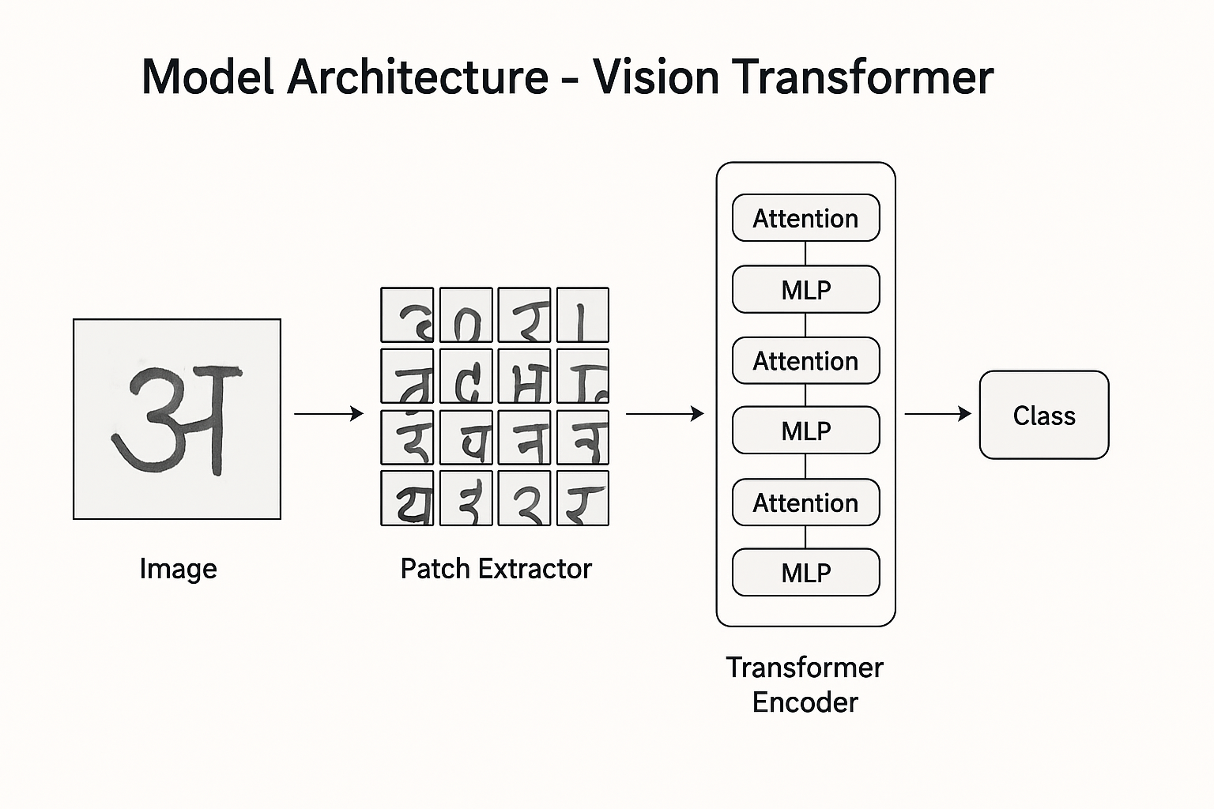
MODEL ARCHITECTURE

Slide 7
PREPROCESSING
1
2
3
4
IMAGE SIZE
Batch Size
Normalization
Data Pipeline
Images resized to 64 × 64 pixels
32 samples per batch
Pixel values scaled to the range [0, 1]
Shuffling (buffer = 1000) for randomness
5
Prefetching
OUTPUT
Prefetching for faster GPU pipeline
train_ds, test_ds

Slide 8
Model Architecture – Vision Transformer (ViT)
01 | Core Idea
 | Applies transformer encoder layers directly to image patches instead of sequence data
02 | Patch Extraction:
 | Custom Patches layer divides input images into 8×8 non-overlapping patches
03 | Patch Encoding
 | PatchEncoder projects each patch into a 64-dimensional embedding
04 | Transformer Encoder Layers
 | 6 layers total

Slide 9

Transformer Encoder Layers
Layer Normalization
Add & Normalize residual connection
Multi-Head Self Attention (4 heads)
MLP block with GELU activation and dropout

Slide 10
Training Setup
01
Input Shape
ML
Optimizer
02
64, 64, 3
Adam
(learning rate = 1e-4)
Model Configuration
03
Loss Function
Metric
04
Sparse Categorical Crossentropy
Accuracy
05
Epochs
Dropout Rate
06
80
0.1 throughout model
07
Training Visualization
Hardware
08

Slide 11
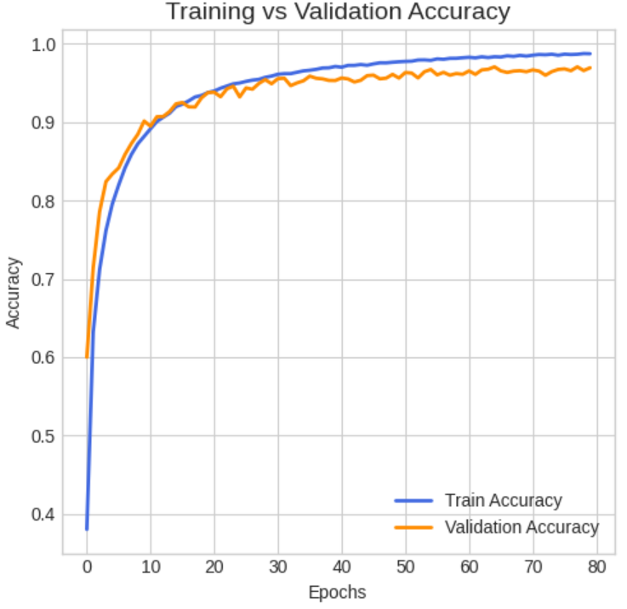
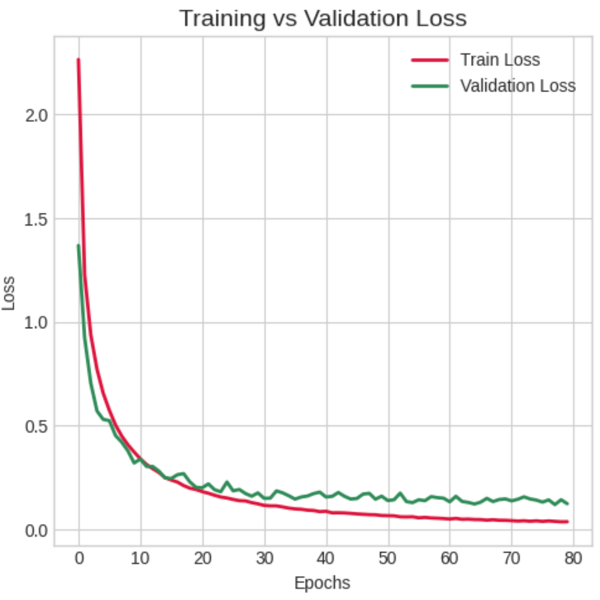
MODEL EVALUATION
Vs

Slide 12
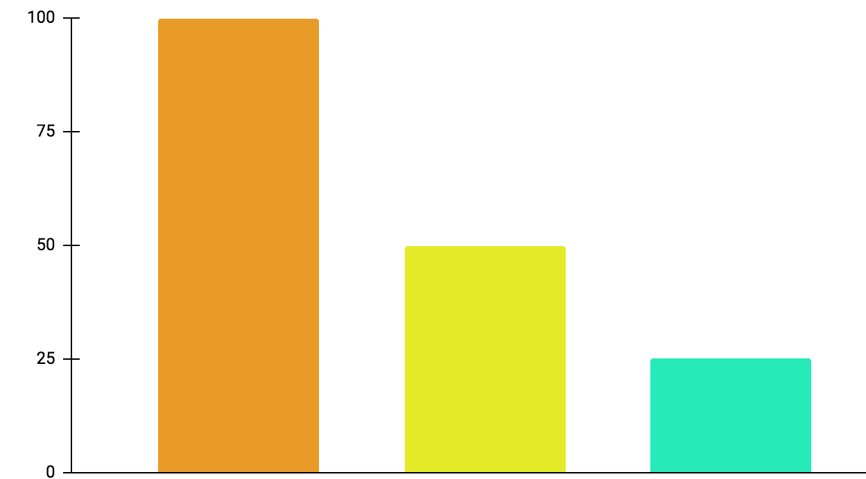
MODEL EVALUATION
01
Accuracy
02
Precision
03
Recall
97%
97%
97%

Slide 13
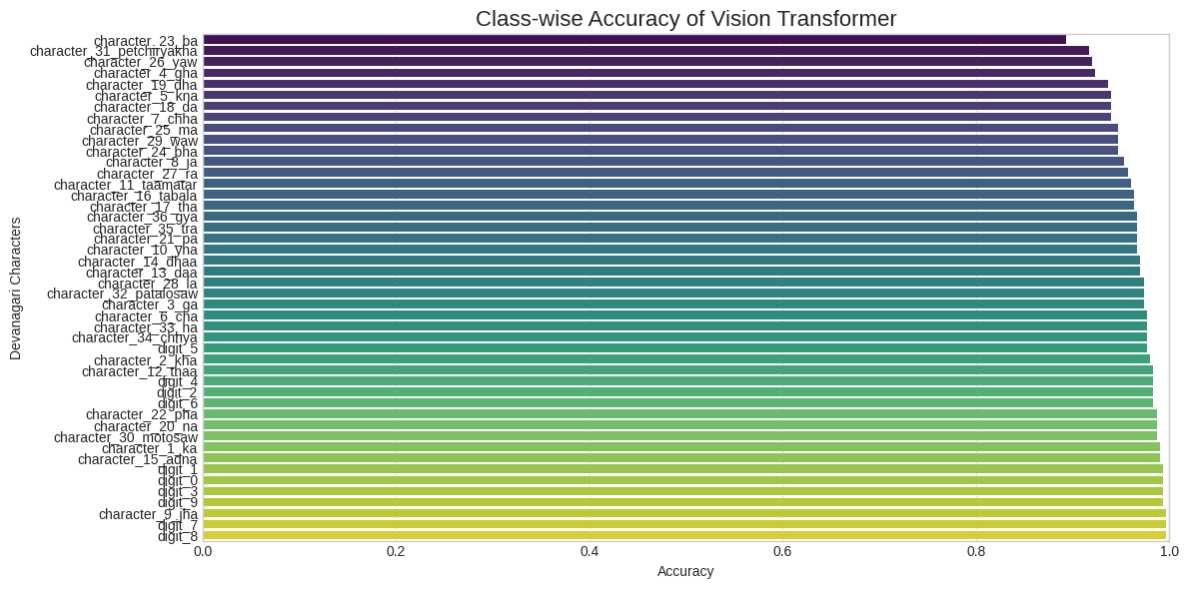
MODEL EVALUATION contd.

Slide 14
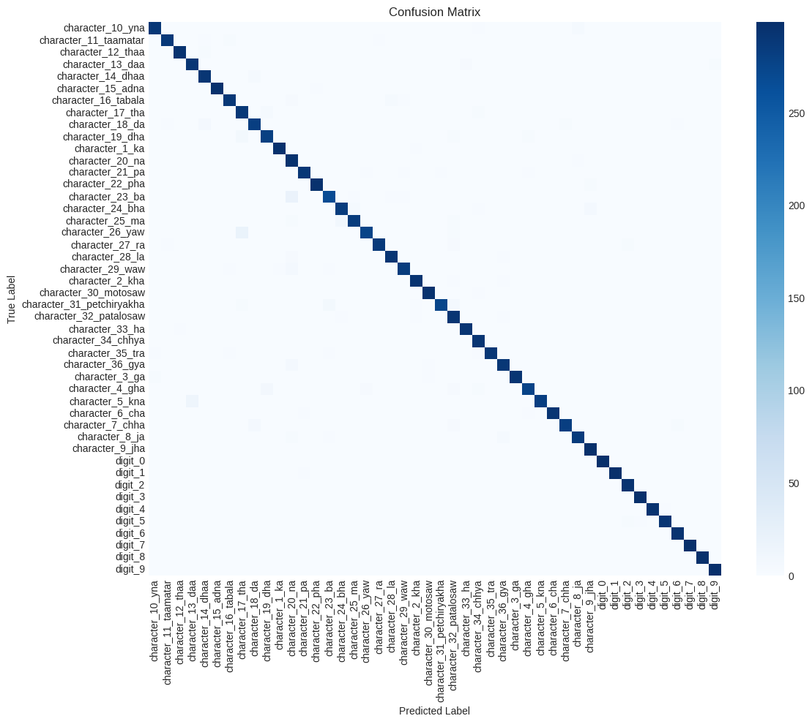
MODEL EVALUATION contd.

Slide 15
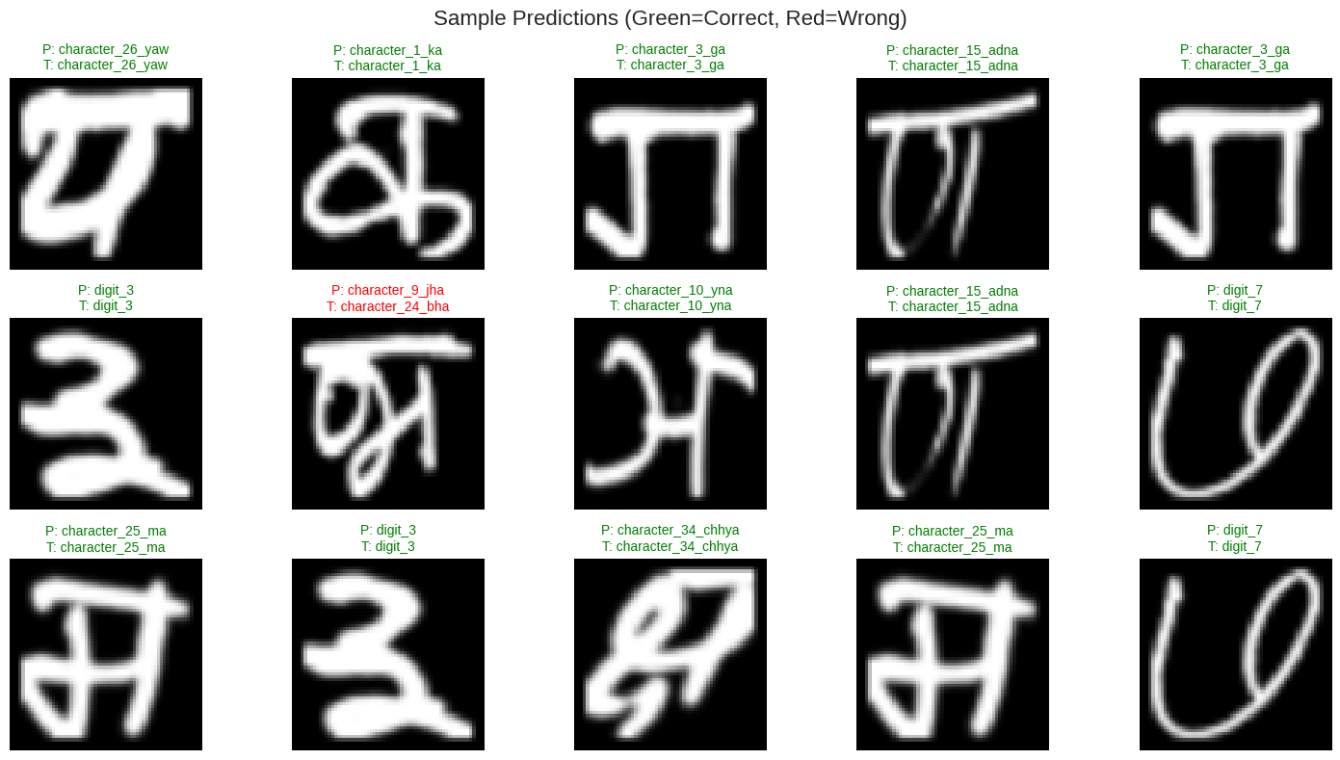
MODEL EVALUATION contd.

Slide 16

MODEL DEPLOYMENT
Streamlit
devnagari-character-predictor-xwy93napvjb8m6b8wdlcsz.streamlit.app

Slide 17
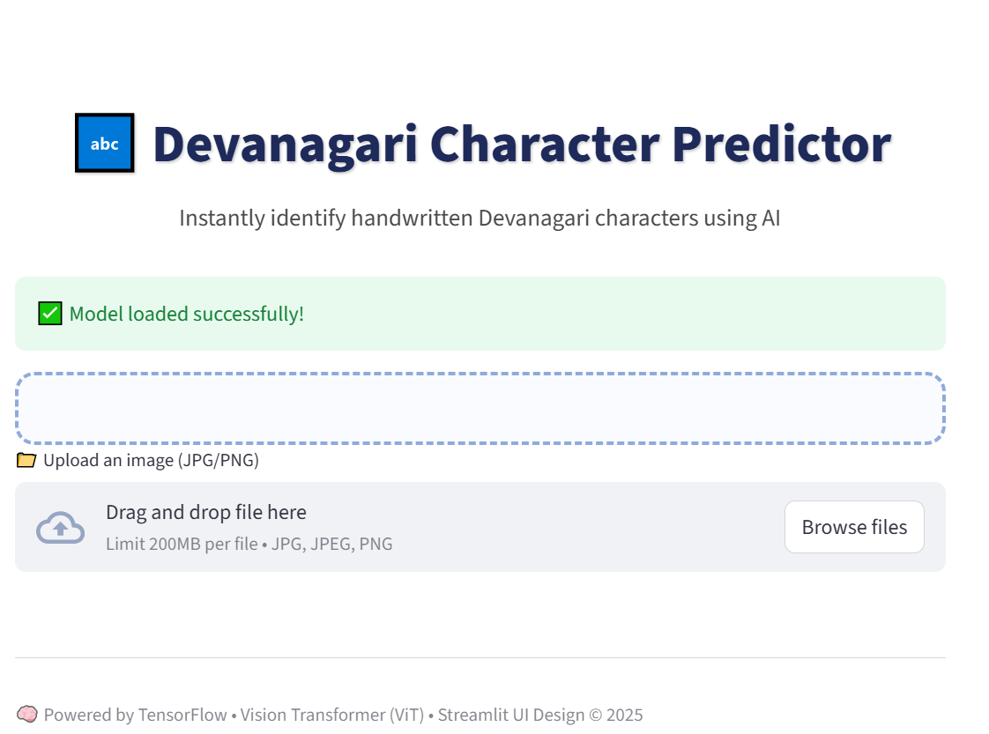
MODEL DEPLOYMENT contd.

Slide 18
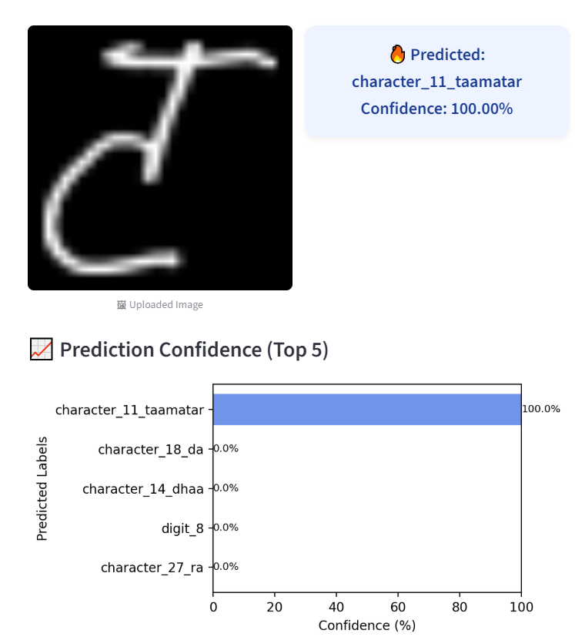
MODEL DEPLOYMENT CONTD.

Slide 19
Thank you for attendig
Happy Learning…

